Slide 1

ETA Decoded
Ensuring You Stay on Schedule for What Matters Most
Group: The Frequent Flyers
Notes:
Linda

Slide 2
The Team
Data Cleaning, EDA, Relevant Features
Lei
Baseline Model 1
Feature Engineering/ Baseline Model 2
Linda
Audrey
Linear Regression
Logistic Regression
Decision Tree
Random Forest
Elsie
Naima
Diana
Maya
Notes:
Linda

Slide 3
OUTLINE
Project Introduction
The Dataset
Our Methods
Results
Notes:
Linda

Slide 4
Introduction
Research Questions
Motivation
Stakeholders
How can we predict flight arrival delays accurately using available flight and operational data?
Improving Airline Operations
Enhancing the passenger experience
Airlines
Passengers
Airport Employees
Notes:
Linda
Describe your research question(s) and discuss the project context and motivation (who are the stakeholder(s) and what are the benefits to them?)

Slide 5
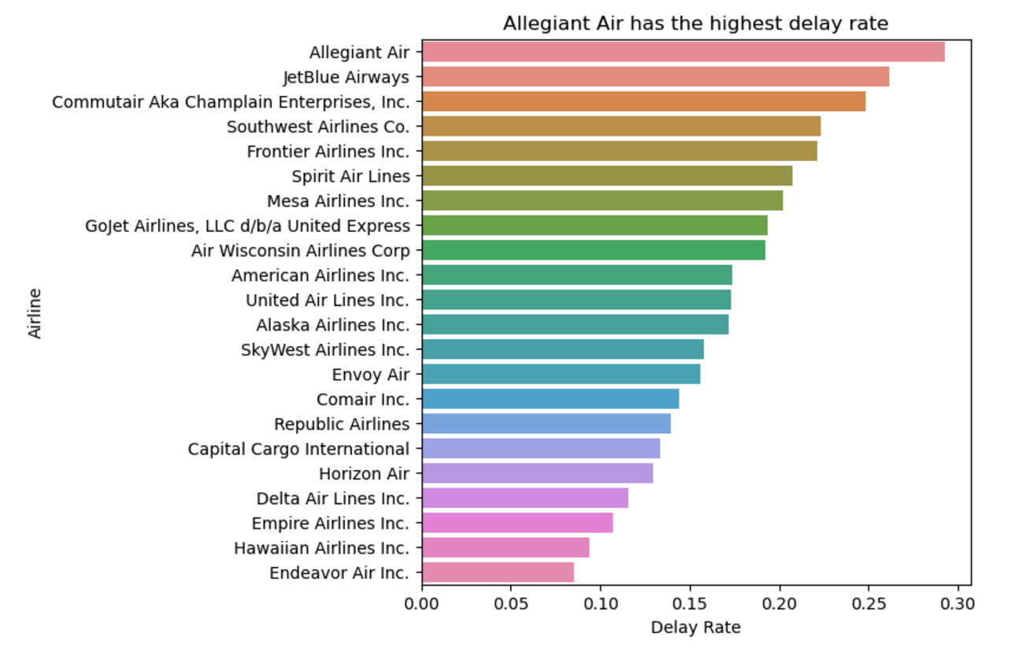



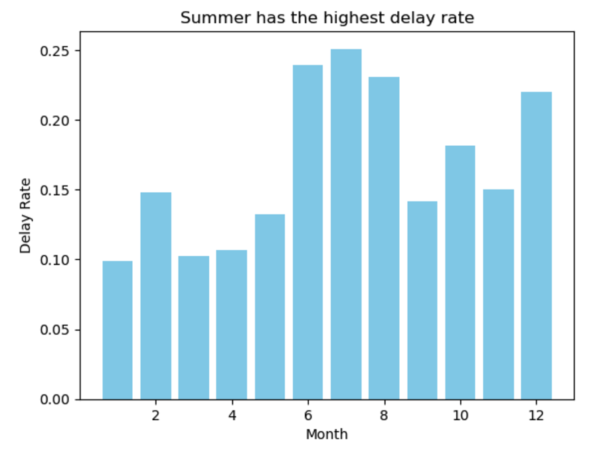
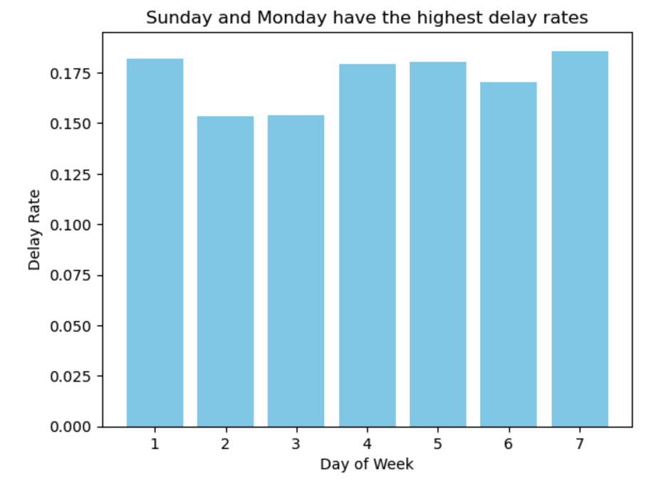
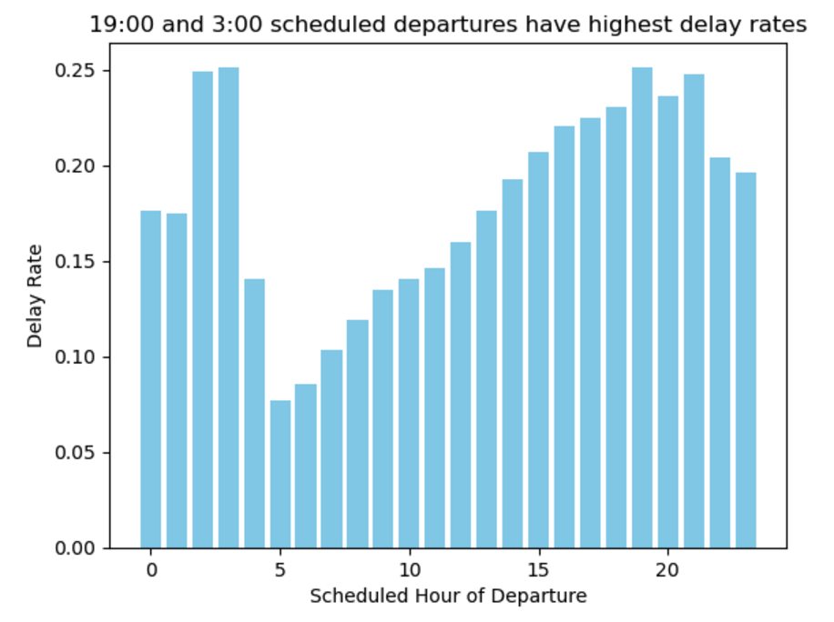
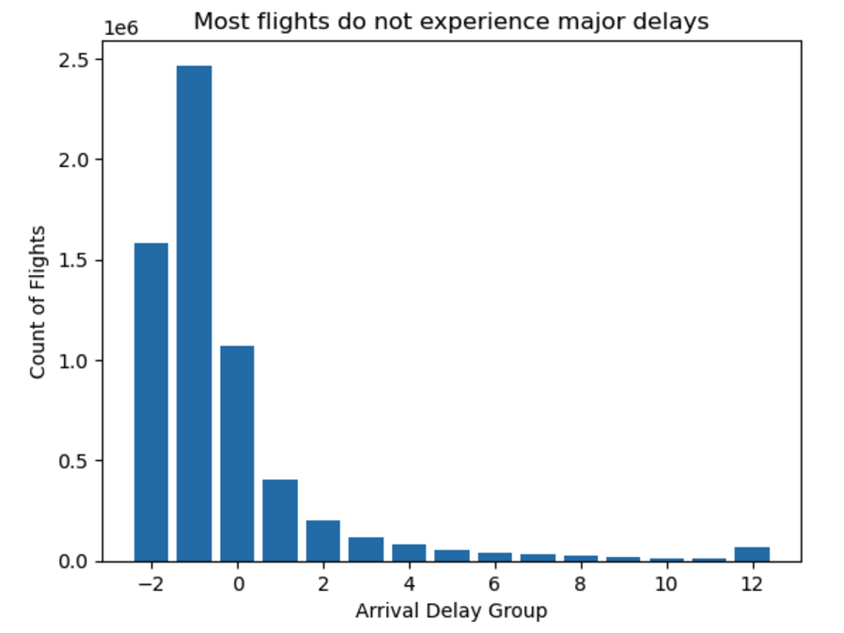
The Dataset
Dataset: Combined_Flights_2021.csv
Original Shape: 6,311,871 instances, 61 columns
Class Imbalance: ~82.7% of instances belong to the negative class
Notes:
Lei Dataset: Describe the raw dataset: where or how did you collect it, descriptives

Slide 6

PRE-PROCESSING
Relevant
Feature Selection
Data Cleaning
EDA
Feature Engineering
Selecting relevant or potentially important features for our modeling objectives
Handle null values, data types, invalid entries, and duplicated records
Examine summary statistics, distributions, outliers, correlations, unique values, and create visualizations
Creating new variables to improve predictive power and ensure better insights
EDA
Notes:
Lei
Steps

Slide 7
Relevant Feature Selection
Target Variable Selection
From the 61 columns, we chose 21 columns as relevant or potentially important features for our modeling objectives, categorized into 7 groups.
We plan to choose at most 1 feature from each group to avoid redundancy and multicollinearity.
The 7 feature groups include:
Flight Date: When is the scheduled flight date?
Flight Time: When is the scheduled departure time or arrival time?
Airline: Which airline will operate the flight?
Flight Number & Aircraft Number: What’s the flight number & which aircraft was used?
Origin Location: Where is the flight planned to take off from?
Destination Location: Where is the flight planned to land?
Distance: What’s the distance between planned origin and destination airports?
Target variables for each type of prediction:
Continuous Prediction: ArrDelayMinutes
Binary Prediction: ArrDel15
Categorical Prediction: ArrivalDelayGroups
Notes:
Lei

Slide 8
Feature Engineering
Engineered variables to capture relationships:
Weekend & Holiday Indicators: Flagged travel patterns for non-working days.
Seasonal Labels: Highlighted weather impacts on delays.
Airport Capacity: Quantified origin/destination operational load.
Delay Trends by Aircraft: Captured per-aircraft delay histories.
Balanced dimensionality using one-hot encoding and scaled numeric features to improve model performance.
*** Observed Potential Data leakages
Started with 21 columns after initial selection.
Expanded to 57 columns after tuning and feature engineering.
Notes:
Audrey feature engineering, filtering, etc.
Feature Selection:
Removed target-related columns (e.g., ArrDelayMinutes, DepDel15) to avoid target leakage.
Used operational and contextual features like Distance, AvgDelaysPerAircraft, and one-hot encoded airlines.
Feature Engineering:
Created interaction features (e.g., Distance_AvgDelays) to capture relationships between distance and aircraft delay history.
Standardized numerical features to improve model performance.
Data Handling:
Addressed outliers by capping delay values at the 95th percentile.
Split data into training and testing sets using an 80/20 ratio and stratified sampling

Slide 9
Methods

Slide 10
Methods Overview
Pre-processing
Modeling
Evaluation & Tuning
Objective 1: Will a flight be delayed?
Objective 2: Severity of delay
Data cleaning
Feature engineering
Recall
RMSE
Notes:
Jumping into the model building…as mentioned earlier, we took two approaches to responding to the issue of flight delays.
In considering our passengers as stakeholders and airlines being able to maintain their trust, we first looked at answering the question of whether or not a flight would be delayed as a binary classification problem.
For our second question, we looked at predicting the severity of the delay as a linear regression challenge with the goal of being able to predict delays at the minute level.

Slide 11
Model 1
Model 2
Predict whether or not a flight arrival will be delayed
Predict how much (in minutes) the flight will be delayed
Target Variable: ArrDelay15
Approach:
Logistic Regression
Decision Trees
Random Forests
Metrics: Recall, Precision, Accuracy, F-1, AUC
Evaluation & Tuning: Threshold optimization, hyperparameter tuning, class adjustments, cross-validation, confusion matrix, classification report
Target Variable: ArrDelayMinutes
Approach:
Built a regression model to predict how long in minutes will a flight be delayed to arrival at destination.
Metrics: RMSE, MAE, R-squared
Evaluation & Tuning: Feature selection, hyperparameter tuning, ridge/lasso regression, cross-validation
Notes:
Diana
MODEL 1
For our first goal of predicting whether or not a flight arrival would be delayed, we used 15 minutes as our threshold for what we classified as delayed or not.
To do this, we considered the target ArrDelay15 and we created logistic regression, decision trees, and random forests models.
And for our metrics, we started with accuracy but as we considered the different types of errors and their effects on stakeholders, we actually shifted to focusing on improving recall, precision and F-1 scores, with the assumption that false negatives are the most frustrating and trust-decreasing
Our evaluation and tuning techniques included:
MODEL 2
For our second question related to severity of delay, our target variable was the arrival delay in minutes. To do this, we started with a linear regression model using RMSE as the initial metric but adding in MAE, R-squared as we continued to evaluate and tune.
Our techniques and methods for this model included feature selection, hyperparameter tuning, ridge, lasso and polynomial regression

Slide 12
Model 1 Performance and Metrics
Model | Accuracy | Recall* | Precision | F-1
Logistic Regression | 62.54 | 62.67 | 25.86 | 0.3662
Decision Tree | 64.43 | 63.50 | 27.22 | 0.3811
Random Forest | 69.58 | 79.10 | 33.75 | 0.4731
Notes:
Naima/Diana/Maya

Slide 13
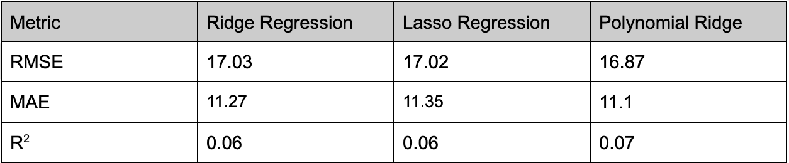
Model 2 Performance and Metrics
The Polynomial Ridge model performed best among the evaluated approaches, demonstrating slight improvements in predictive accuracy.
The models explained only 6%–7% of the variance in arrival delays, indicating that a linear model does not capture
Notes:
Elsie Root Mean Squared Error (RMSE):
Lower RMSE show that the model is making more accurate predictions. It decreased from 45.41 to 15.60 showing that the error between predicted and actual flight delay durations has been reduced significantly.
R² Score:
R² measures how much of the variance in the target variable (ArrDelayMinutes) is explained by the model. It increased from 0.07 to 0.21 indicates the model explains a larger proportion of the variance, therefore the added interaction variable and feature scaling improved the model’s predictive power.
For the linear regression model, we were predicting the arrival delay minutes - thaat is the number of minutes by which a passenger could be delayetd by
For tuning the model, we implemented Ridge and Lasso regression models for their ability to handle multicollinearity and perform feature selection. which was important for this high dimensional dataset with potentially redundant features.
We first used a grid search function to optimize the alpha parameter (which controls the regularization strength) but found it to be computationally expensive because of the exhaustive parameter testing so we used RandomizedSearchCV instead, which sampled from a uniform distribution of alpha values. To capture non-linear relationships, we expanded the top 20 most predictive features (based on the Lasso regression feature importance) into second degree polynomial features. This allowed the model to account for interactions between variables and higher order effects. The expanded feature set was standardized and used with Ridge regression which resulted in a slight performance in improvement.
We also used 5 fold cross-validation in this process to enhance performance across different subsets of the data.
Root Mean Squared Error (RMSE): To penalize large errors in predictions.
Mean Absolute Error (MAE): To measure the average magnitude of errors.
R² Score: To assess the proportion of variance explained by the mode

Slide 14
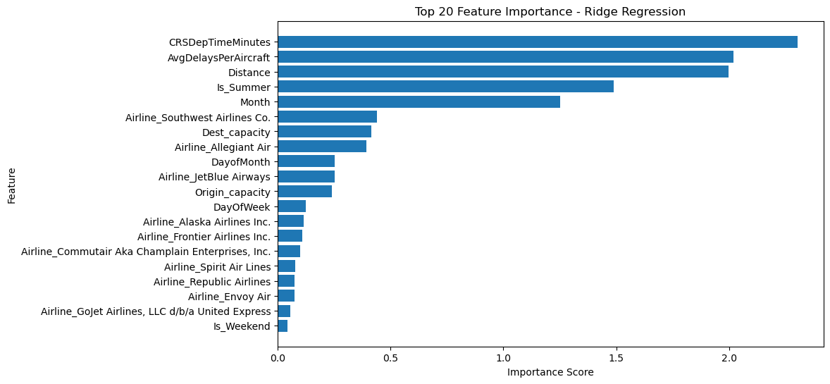
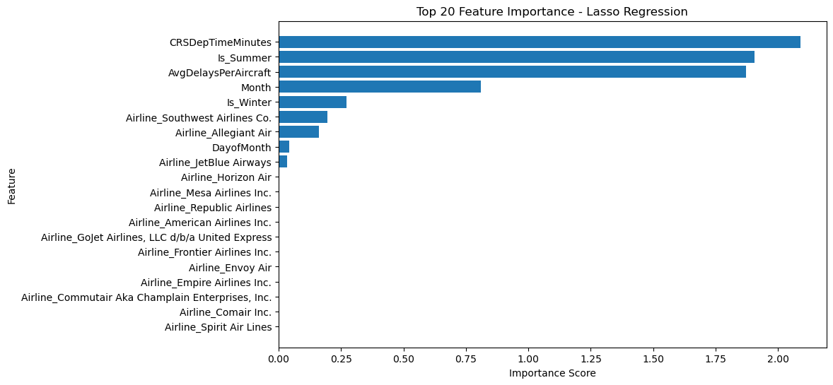
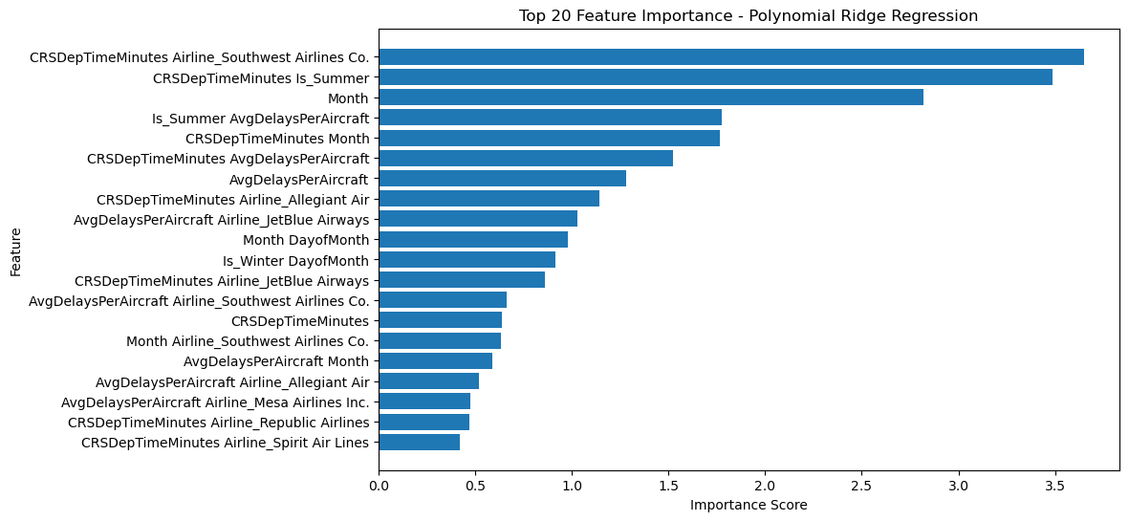
Model 2 Feature Importance

Slide 15
Real-World Implications
Average of over 100,000 commercial flights operating per day globally
Average of 30,000 delayed flights per day globally
Benefit of accurate predictions:
True positives/True negatives
Cost of inaccurate predictions:
False positives/False negatives
Ready for the real-world?
Real-time/live data: weather, maintenance issues, air traffic, global events, etc.
Adaptive modeling: responsive to real-time changes
Notes:
MAYA
Synthesize individual work and provide findings and conclusions. Do not forget to mention the implications of your project and its results. Would you say it's ready to be used in the real-world yet? If not, what needs to be solved before you would say it was ready?

Slide 16
Lessons Learned
High correlation between features
Leakages
Very large dataset
Notes:
Naima

